Slide 1
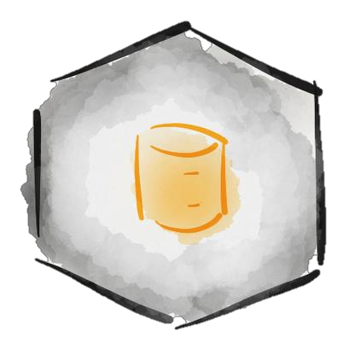
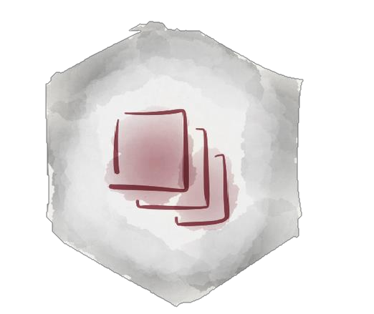
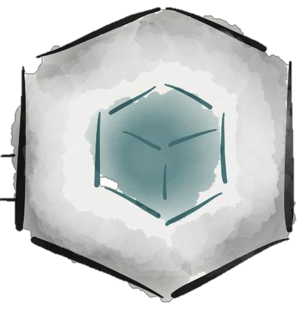
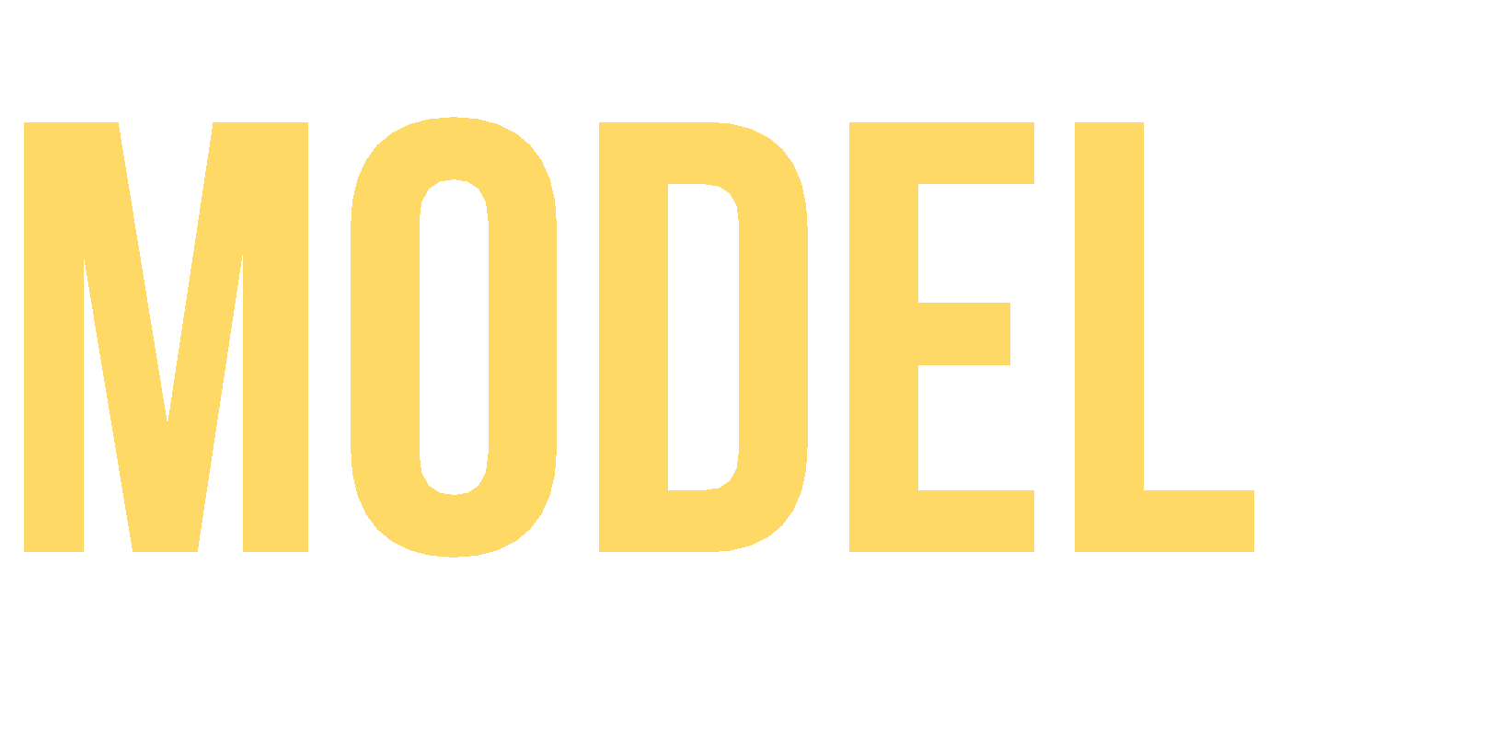



Slide 2
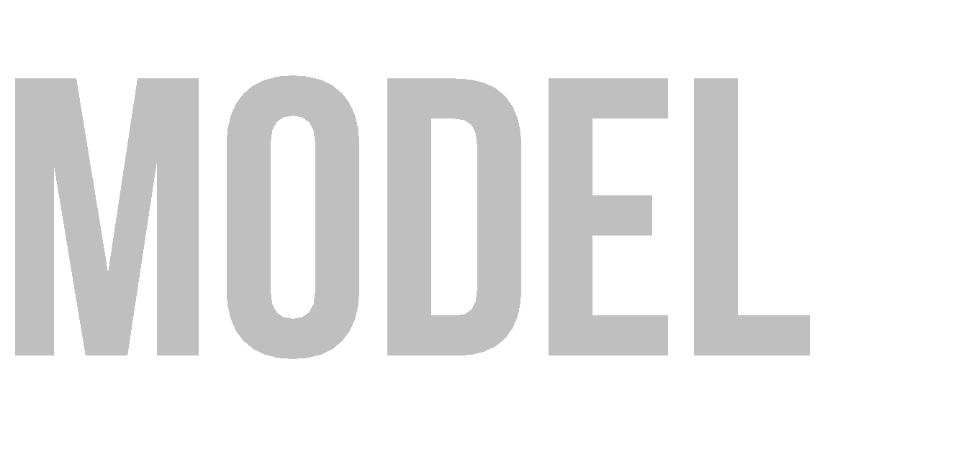


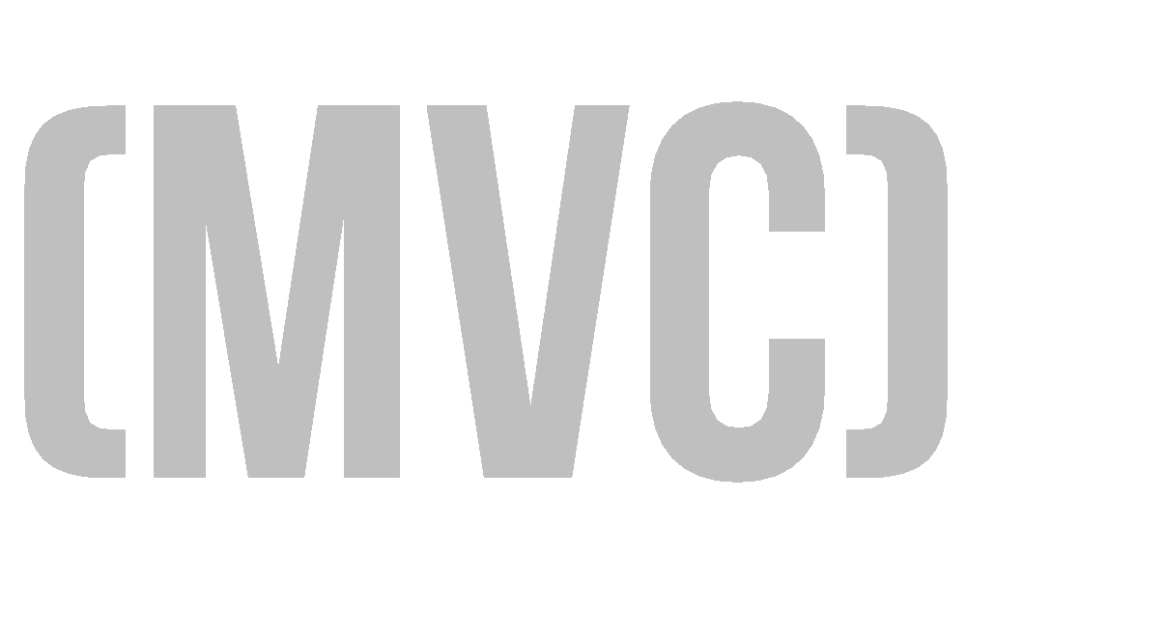
Software architecture pattern that separates the model, the user interface and control logic of an application in three distinct components.

Slide 3

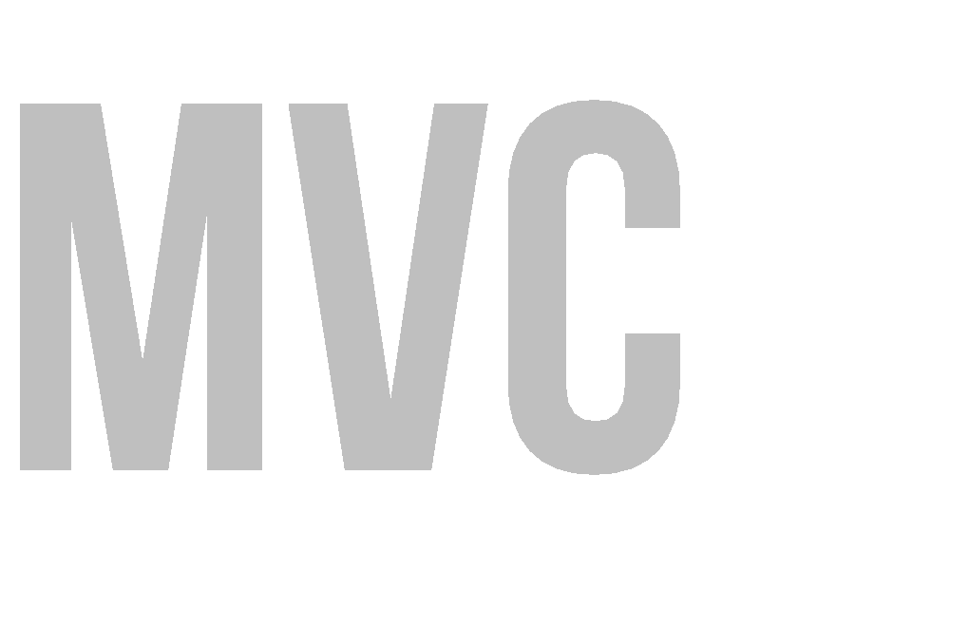

MVC proposes the construction of three distinct components. One side for the representation of information, and on the other hand for user interaction.
One model
Many Views
Many Controllers

Slide 4

The Model
The View
User Interface Interaction elements
The Controller
Representation of domain data. Business logic
Persistence mechanism
Intermediary between Model and View It maps user actions – model actions Select the view and provide information to itself

Slide 5
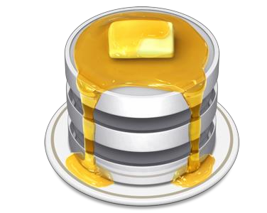
It is the specific representation of the information with which the system operates. Logic ensures the integrity of data and allows to derive it.

Slide 6
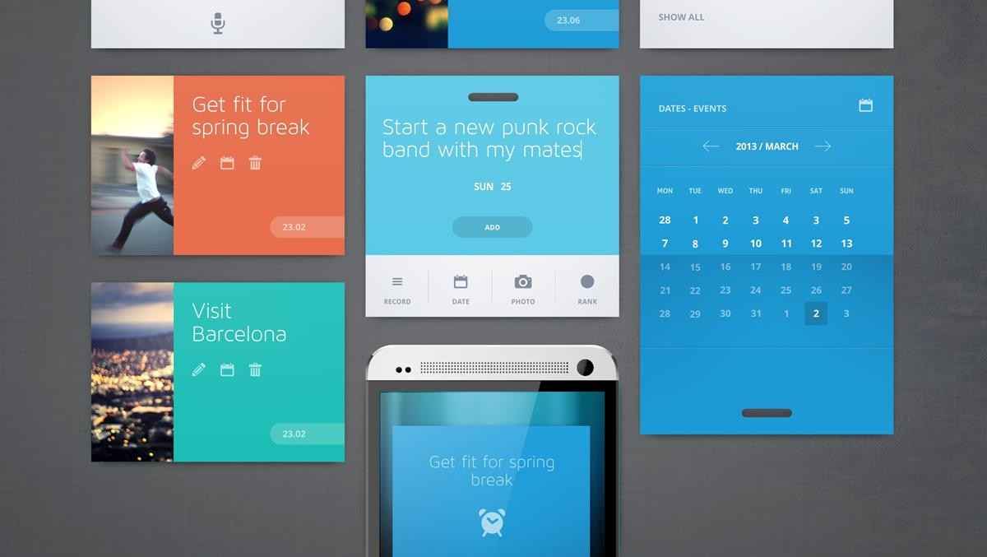
Represents the model in a suitable format to interact and access the data, usually called "User Interface" (GUI Java, HTML, XML).

Slide 7


It is the link between the view and the model, is responsible for receiving and responding to events, typically user actions and invokes changes on the model and probably in the view.

Slide 8
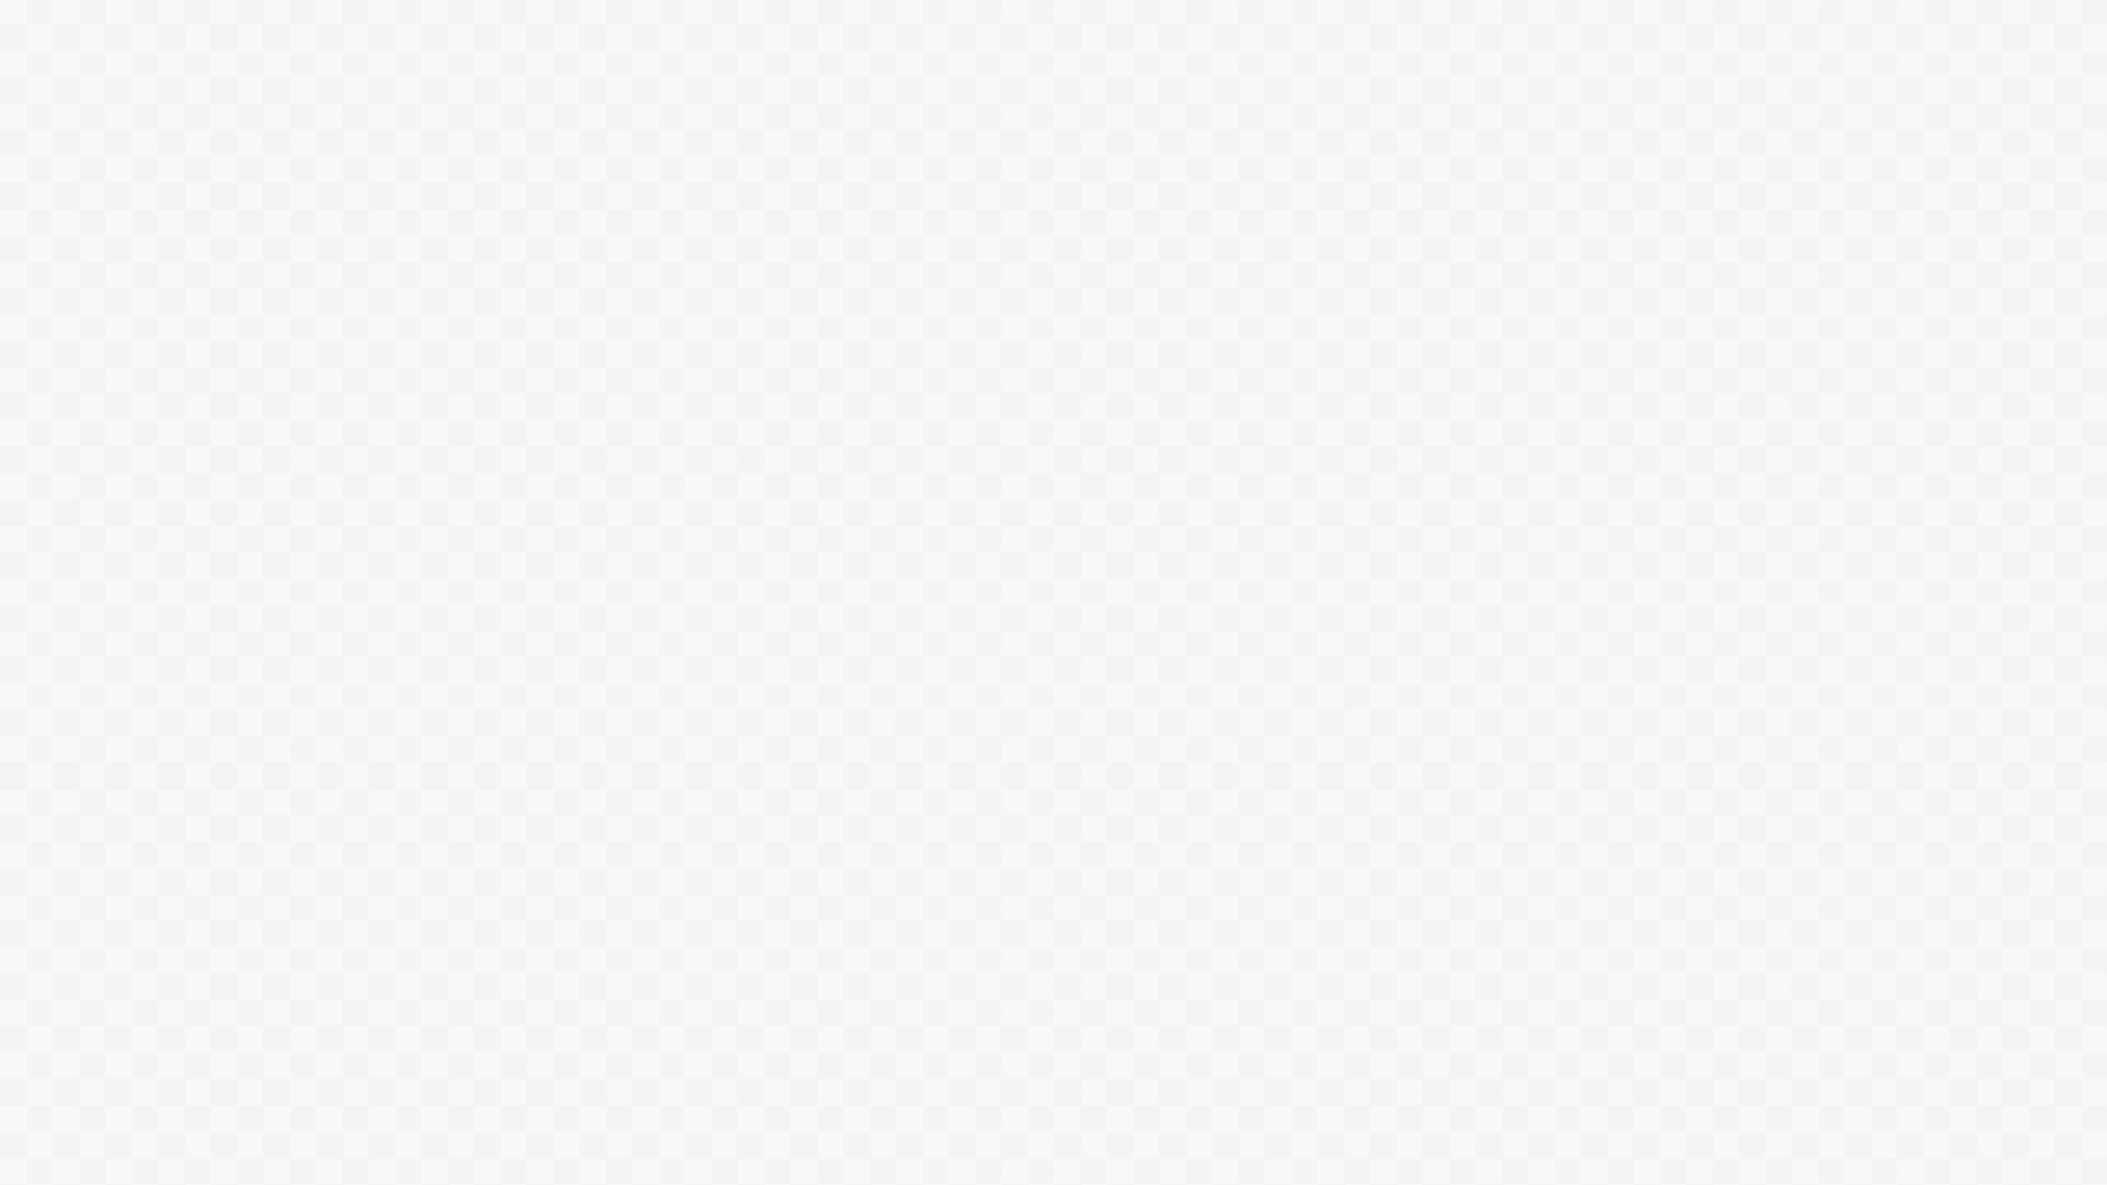

Organization
Rapid Application Development
Reusing Code
Parallel development
It presents the same information in different ways.
The views and application behavior should reflect the manipulations of the data immediately.
It allows different user interface standards or port it to other environments where the application code should not be affected.

Slide 9
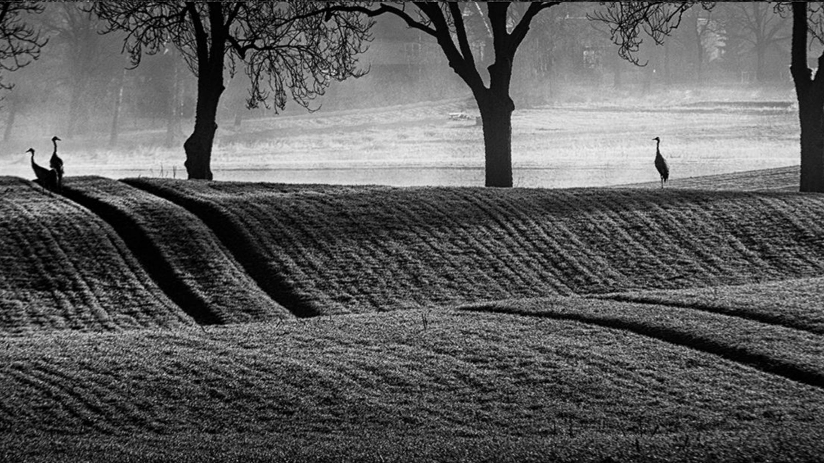

This model is not new, it was introduced in 1987 in the Smalltalk programming language.
With the boom of Web applications, it has proven to be a programming mode that fits quite well with the internet, being both the model and the controller executed server side, and the view on the client side executed.

Slide 10
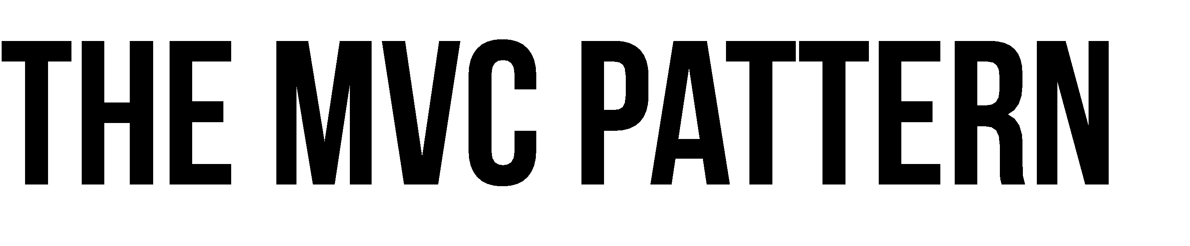
Control Flow
The user performs an action on the interface.
The controller takes the input event.
The controller notifies the user action to the model, which may involve a change of state of the model.
It generates a new view. The view takes the data model.
The user interface waits for another user interaction, which starts a new cycle.

Slide 11





Controller updates the model
View alerts controller of a particular event
View grabs model data and updates itself
Model alerts view that it has changed
User interacts with a
view

Slide 12






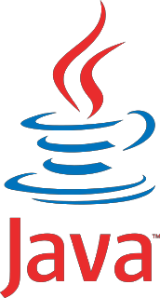
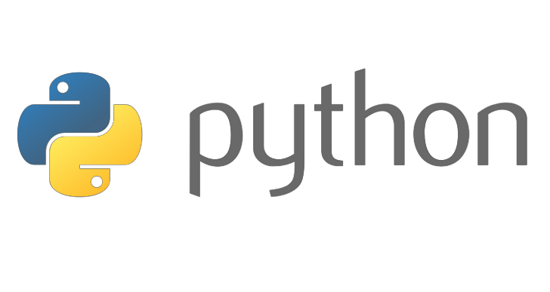

It applies to all types of systems
And technologies (Java, Ruby, Python, Perl, Flex, SmallTalk,. Net, etc..)

Slide 13
MVC IN PHP
Model: It must allow access for the data to be viewed, or collected and written to, and is the bridge between the View component and the Controller component in the overall pattern.
View: The View is where data, requested from the Model, is viewed and its final output is determined.
Controller: The final component of the triad is the Controller. Its job is to handle data that the user inputs or submits, and update the Model accordingly.

Slide 14

THANK YOU!!
EMAIL:

Slide 15
The final component of the triad is the Controller. Its job is to handle data that the user inputs or submits, and update the Model accordingly.

